Slide 1
Selecting a Limited Palette
Using Mixing Lines and Pigment Charts

Slide 2
Why use a Limited Palette?
You learn about mixing pigments in general because you’re forced to do more mixing.
You learn more about the particular pigments you are using. It’s easier to learn about pigment interactions when you have fewer pigments in your palette.
You insure your painting will remain color coordinated.
Helps to guarantee your painting remains in the area of the color wheel you want it.
It’s a great way to experiment with a new pigment.
It’s a way to force yourself out of your comfort zone. In many ways, a palette defines an artist’s style.
Learn how to make the eye ‘see’ colors that are not there – the ‘magic’ of pigments.

Slide 3
What is a ‘Color’?
Three basic parameters define a ‘color’
Hue
Saturation (Chroma, Intensity)
Value (Lightness)
There have been a number of models of the years to define a ‘color space’.
Munsell Color Space is one of the most popular
CIE LAB, etc
All models have limits, but can be helpful in understanding pigment mixing and selection
The ‘color wheel’ is a simplified slice of a color model

Slide 4
Hue: Measured as an Angle
Hue Angle

Slide 5
Saturation: Measured as distance from center
All colors on one spoke of the wheel are same Hue, but different Saturation – known as ‘Shades’

Slide 6
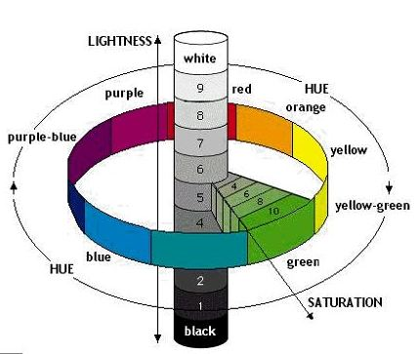
Value: Measured in the 3rd Dimension

Slide 7
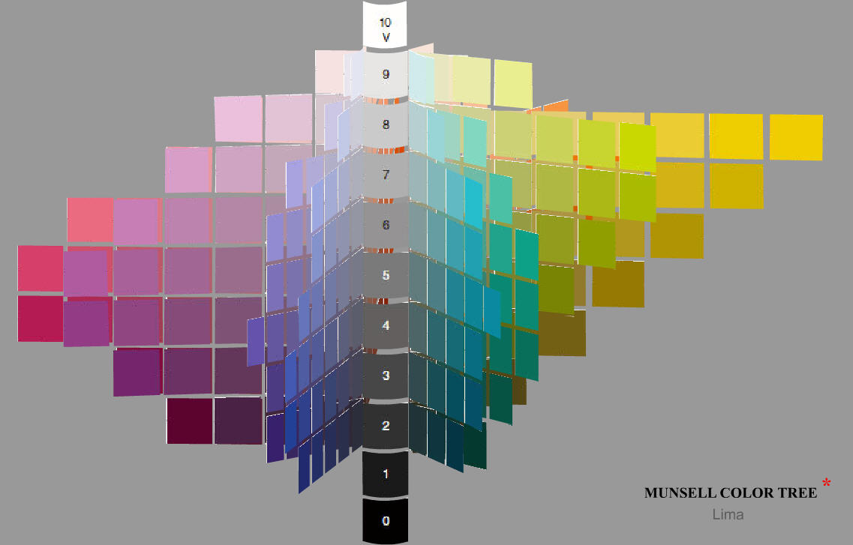
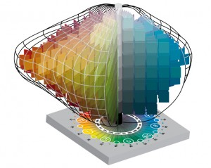
Munsell Color ‘Trees’

Slide 8
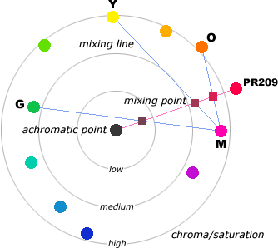
Mixing Lines Connect two colors with a line. Any color on the line can be mixed.
Three different mixes producing the same HUE, but lesser SATURATIONS.
(Note that from this reasoning, one can mix a green and an orange to get a yellow! ☺ )

Slide 9
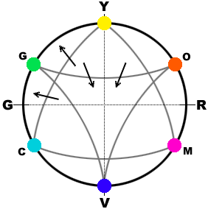
All models have shortcomings
Not all mixing lines are straight.
Connecting the modern primaries – lines curve out (gain saturation).
Connecting the modern secondaries – lines curve inward (lose saturation)
A little interpolation and experience is needed.

Slide 10
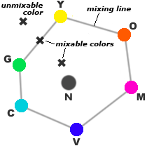
Defining your Color Gamut
Connect your highest saturation colors.
Everything within the polygon is mixable.
Anything else is NOT mixable with this palette

Slide 11
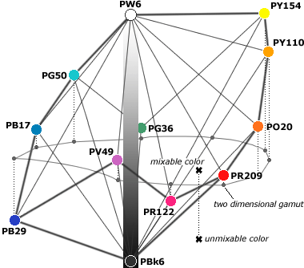
The Color Gamut in 3d
This helps you see the Value Range you have in your Gamut

Slide 12
Switch to Pigment Charts
Color wheels use ‘ideal’ colors.
We work with Pigments, not colors.
Most pigment manufacturers have Color Charts or Pigment Charts. You can use any one – all manufacturers have essentially the same pigments
These work for any wet medium. All artist media are made from the same pigments. The only thing that changes is the vehicle (and the names).

Slide 13
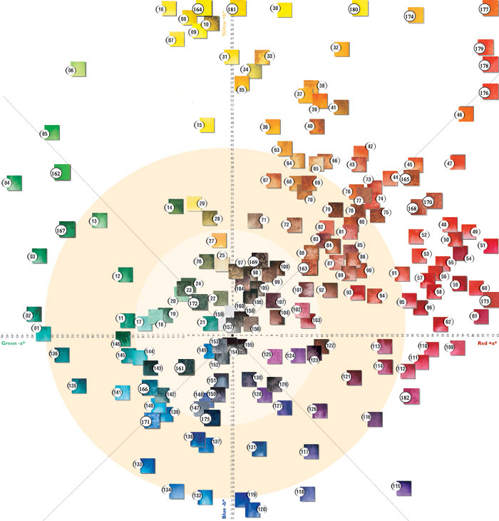
Daniel Smith Pigment Chart

Slide 14
Notes on Pigment Chart
Its NOT a neat circle – colors all over the map
From the yellow-greens thru the oranges there are many more selections with higher saturations. This is due largely to how our eyes perceive color.
The greens that are high-saturation are actually ‘mixes’. They take advantage of the high-saturation yellows and the convex mixing curve that occurs in this quadrant.
Fewer greens, blues, and violets are available compared to yellows, oranges and reds. This is a factor of what we have available in nature and from the chemists
There are only 5 modern single-pigment greens available
There are about 8 modern single-pigment blues
There are dozens of yellows, oranges , and reds
All artist pigment manufacturers have pretty much the same sets of single-pigment paints. Their mixes are often different.
Charts apply to any wet medium
The chart is in 2 dimensions. We cannot see the values of the pigments from this chart.

Slide 15
Palette Selection
Pick your pigments using your pigment chart
Apply your mixing lines to your pigment chart – this defines your color gamut
See if there are any colors that you need that are not within your color gamut.
Let’s look at a few common ‘standard’ palettes
Classic Primaries
Split Primaries
Artist’s Primaries
Modern (Printer’s) Primaries

Slide 16
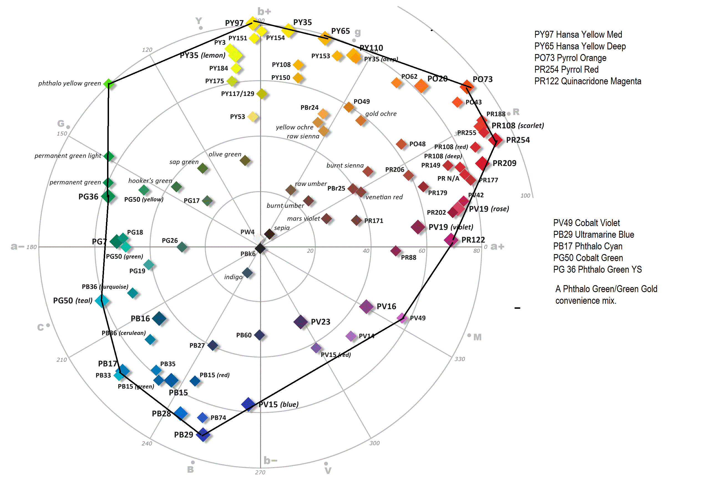
Maximum Saturation Palette

Slide 17
Why not use the max-saturation palette?
We might use some colors so often that we would like to have them right out of the tube, rather than having to mix them
Some hues we use often might only be mixable using THREE of our pigments. This is quite inconvenient.
Some of these pigments might have characteristics we don’t care for
Weak tinting strength: teals and violets are notorious
Un-agreeable working characterics – for example, an opaque pigment when we want transparent
We may need most of our coverage in a specific area of the color wheel – for example, more greens for landscapes or more browns for portraits.

Slide 18
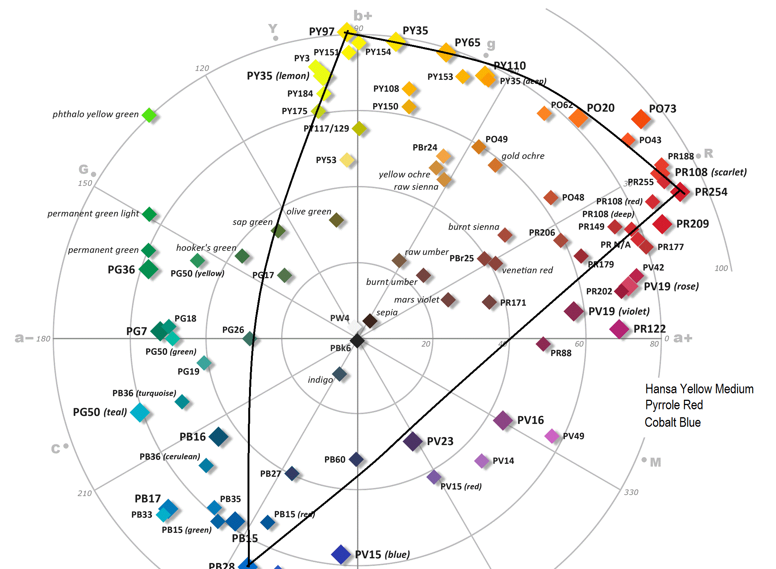
Classic Primaries
Yellow, Red, and Blue

Slide 19
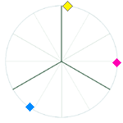
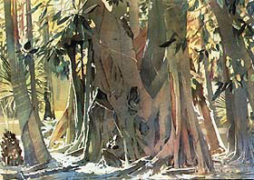
Jean Grastorf – Primary Palette
hansa yellow (PY97), quinacridone rose (PV19), phthalo blue GS (PB15:3)

Slide 20
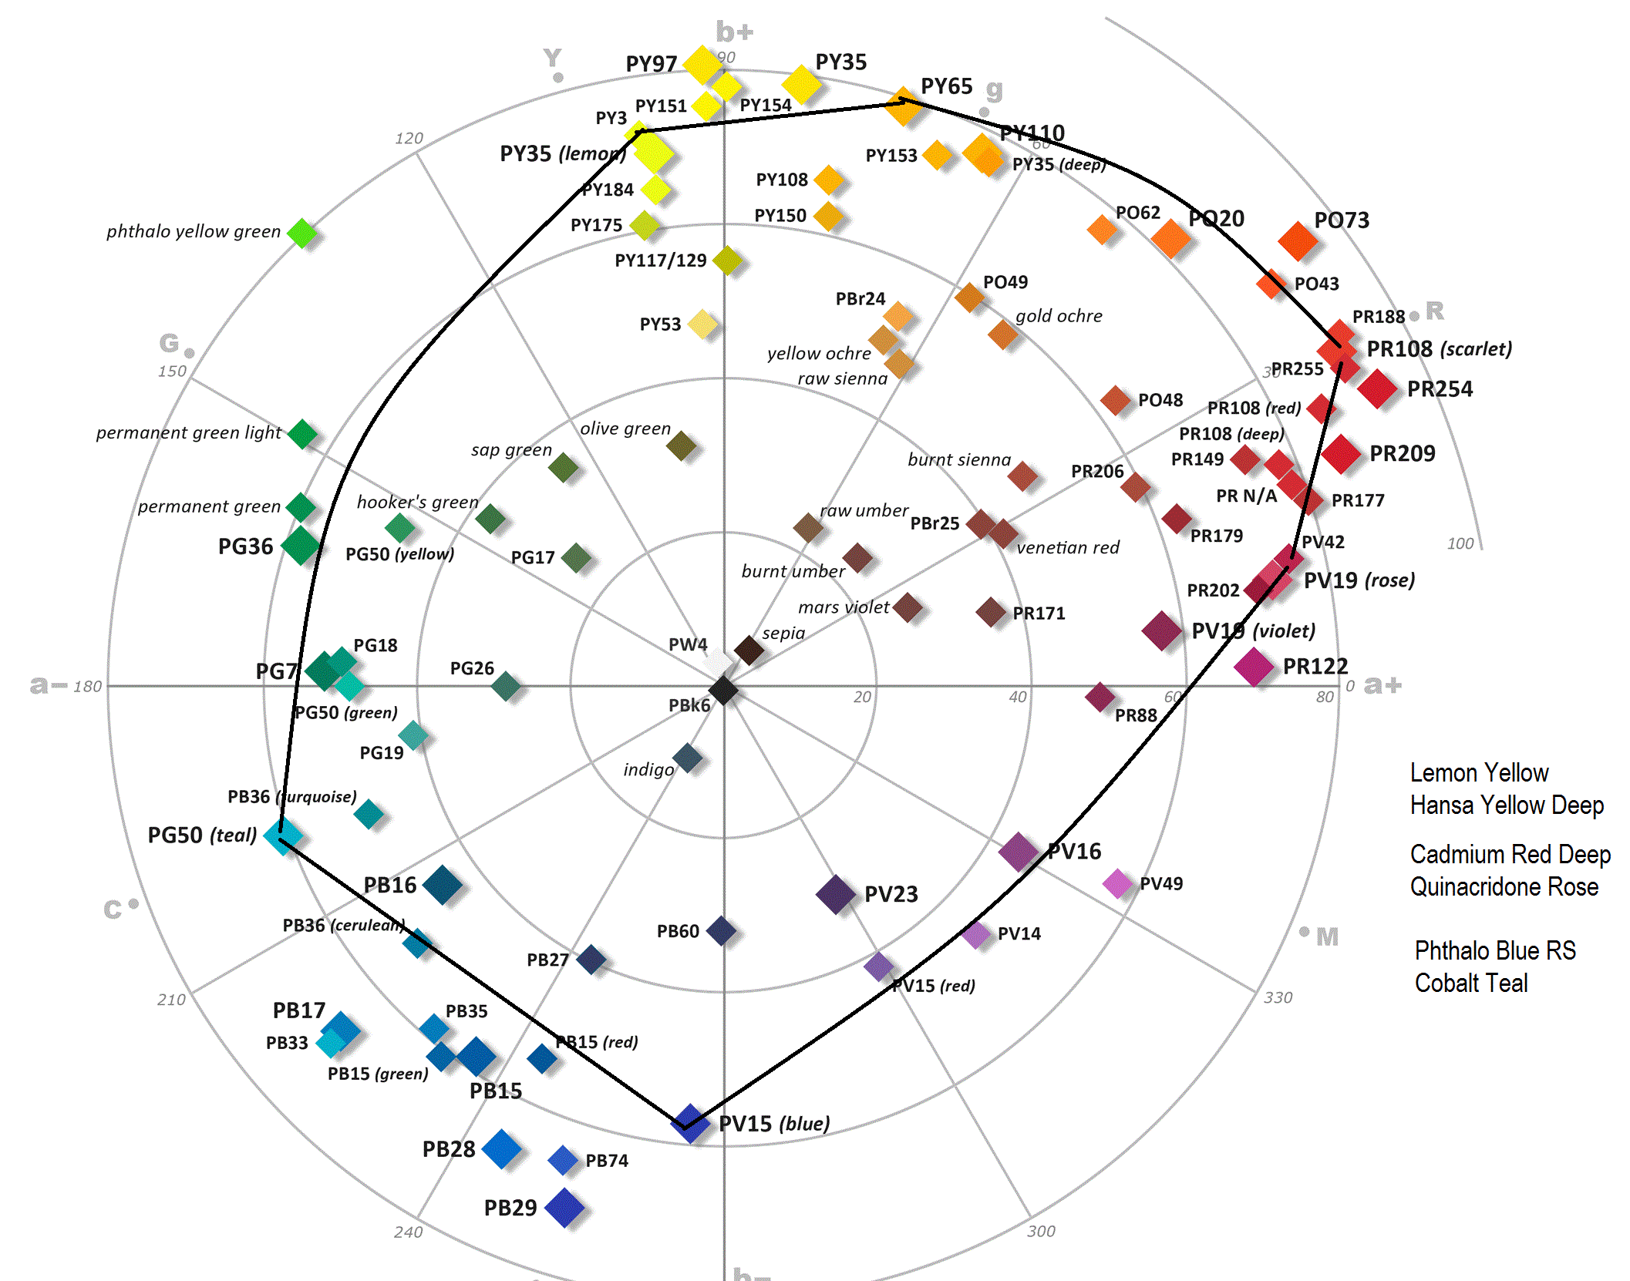
Split Primary Palette
Warm and Cool of yellow, red, and blue

Slide 21
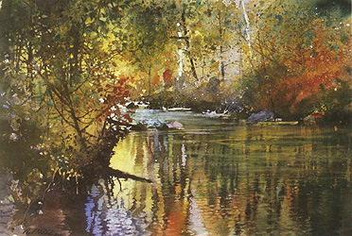
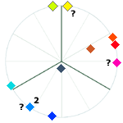
Nita Engel – Split Primary Palette
cadmium yellow lemon (PY37), aureolin (? PY40), quinacridone maroon (PR206), cadmium scarlet (PR108), pyrrole red (PR254), opera (PR122+? PV10), ultramarine blue (PB29), iron [antwerp] blue (PB27), cobalt blue (PB28), cerulean blue (PB35), payne's gray (a mix)
Note the improved intensity in the yellow-greens as well as warm red-oranges

Slide 22
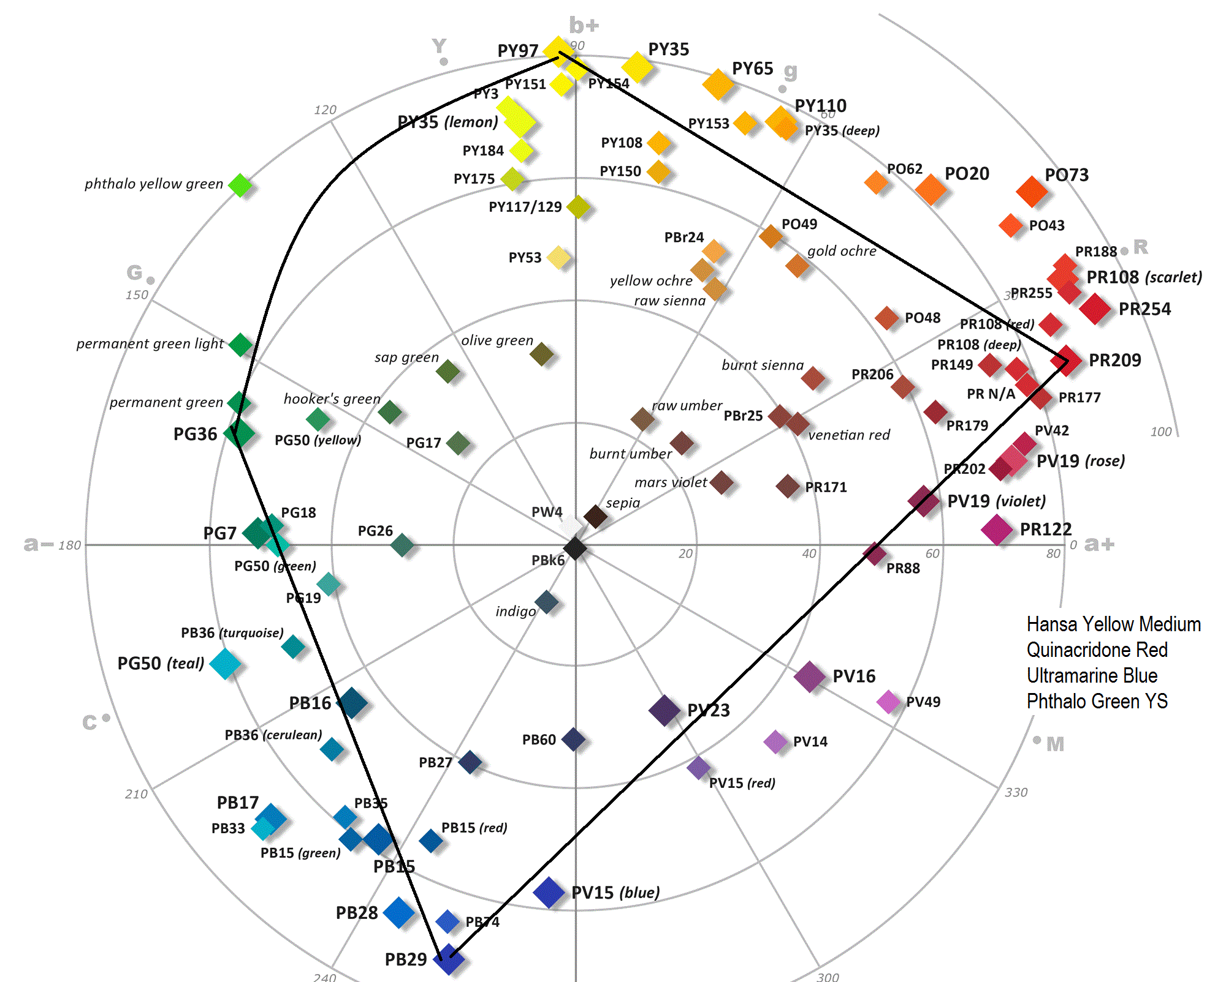
Artist’s Primary Palette
The classic primaries plus green

Slide 23
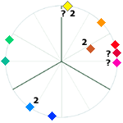
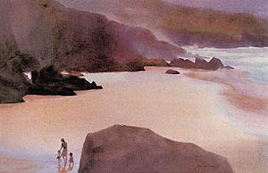
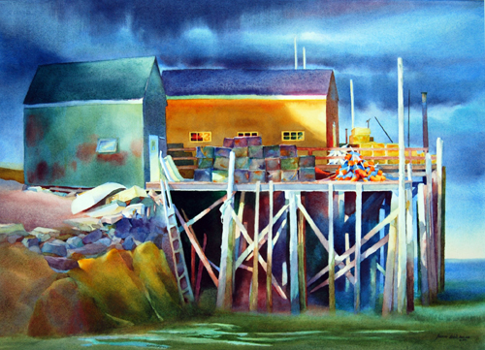
Jean Dobie – Artist’s Primaries
aureolin (? PY40), cadmium yellow (PY35), cadmium orange (PO20), cadmium red (`), rose madder genuine (? NR9), ultramarine blue (PB29), cobalt blue (PB28), phthalocyanine blue RS (PB15:1), viridian (PG18), phthalocyanine green YS (PG36). Note that her palette is kind of a cross between split primary and artist primary.

Slide 24
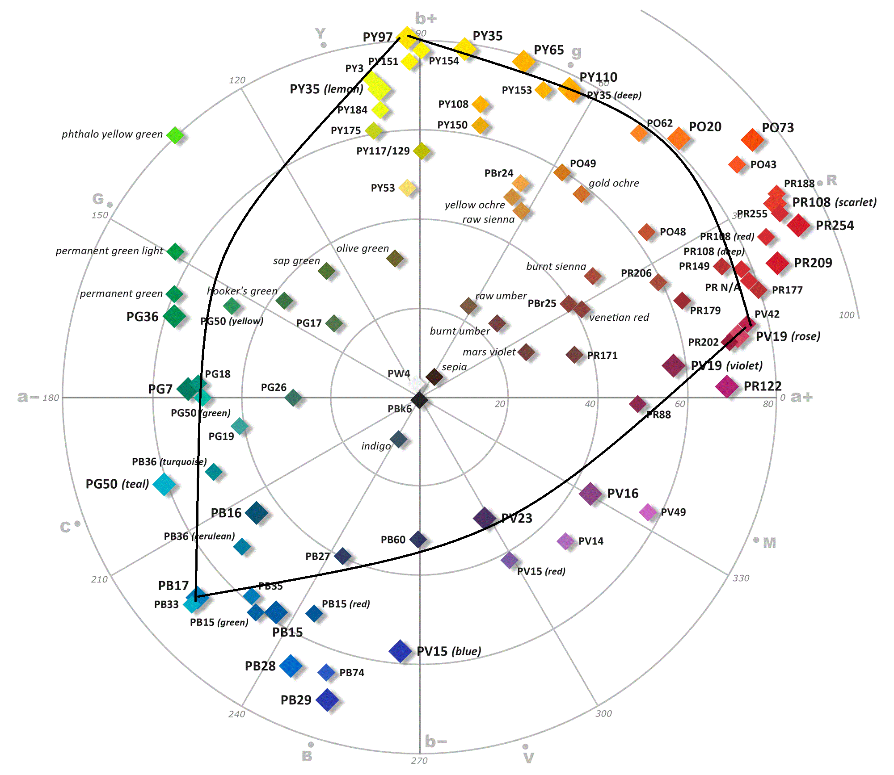
Printer’s (Modern) Primaries
Yellow, Magenta, and Cyan

Slide 25
Examples of Triad Palettes

Slide 26
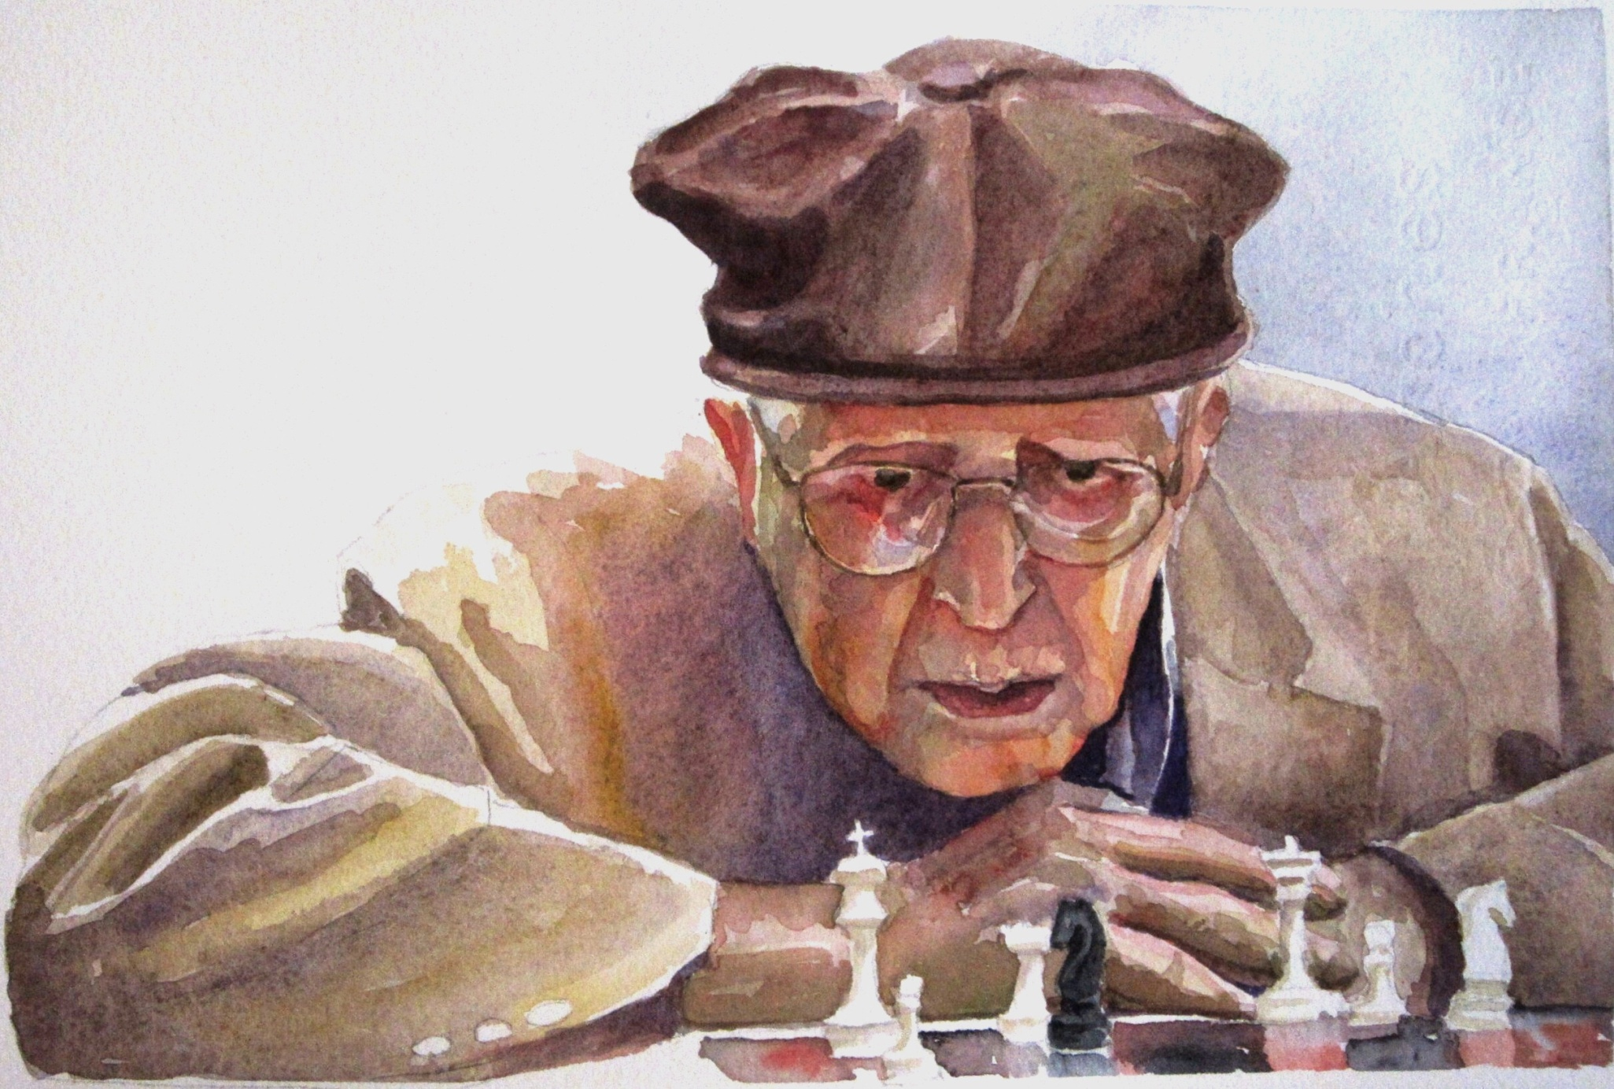
“Check”

Slide 27
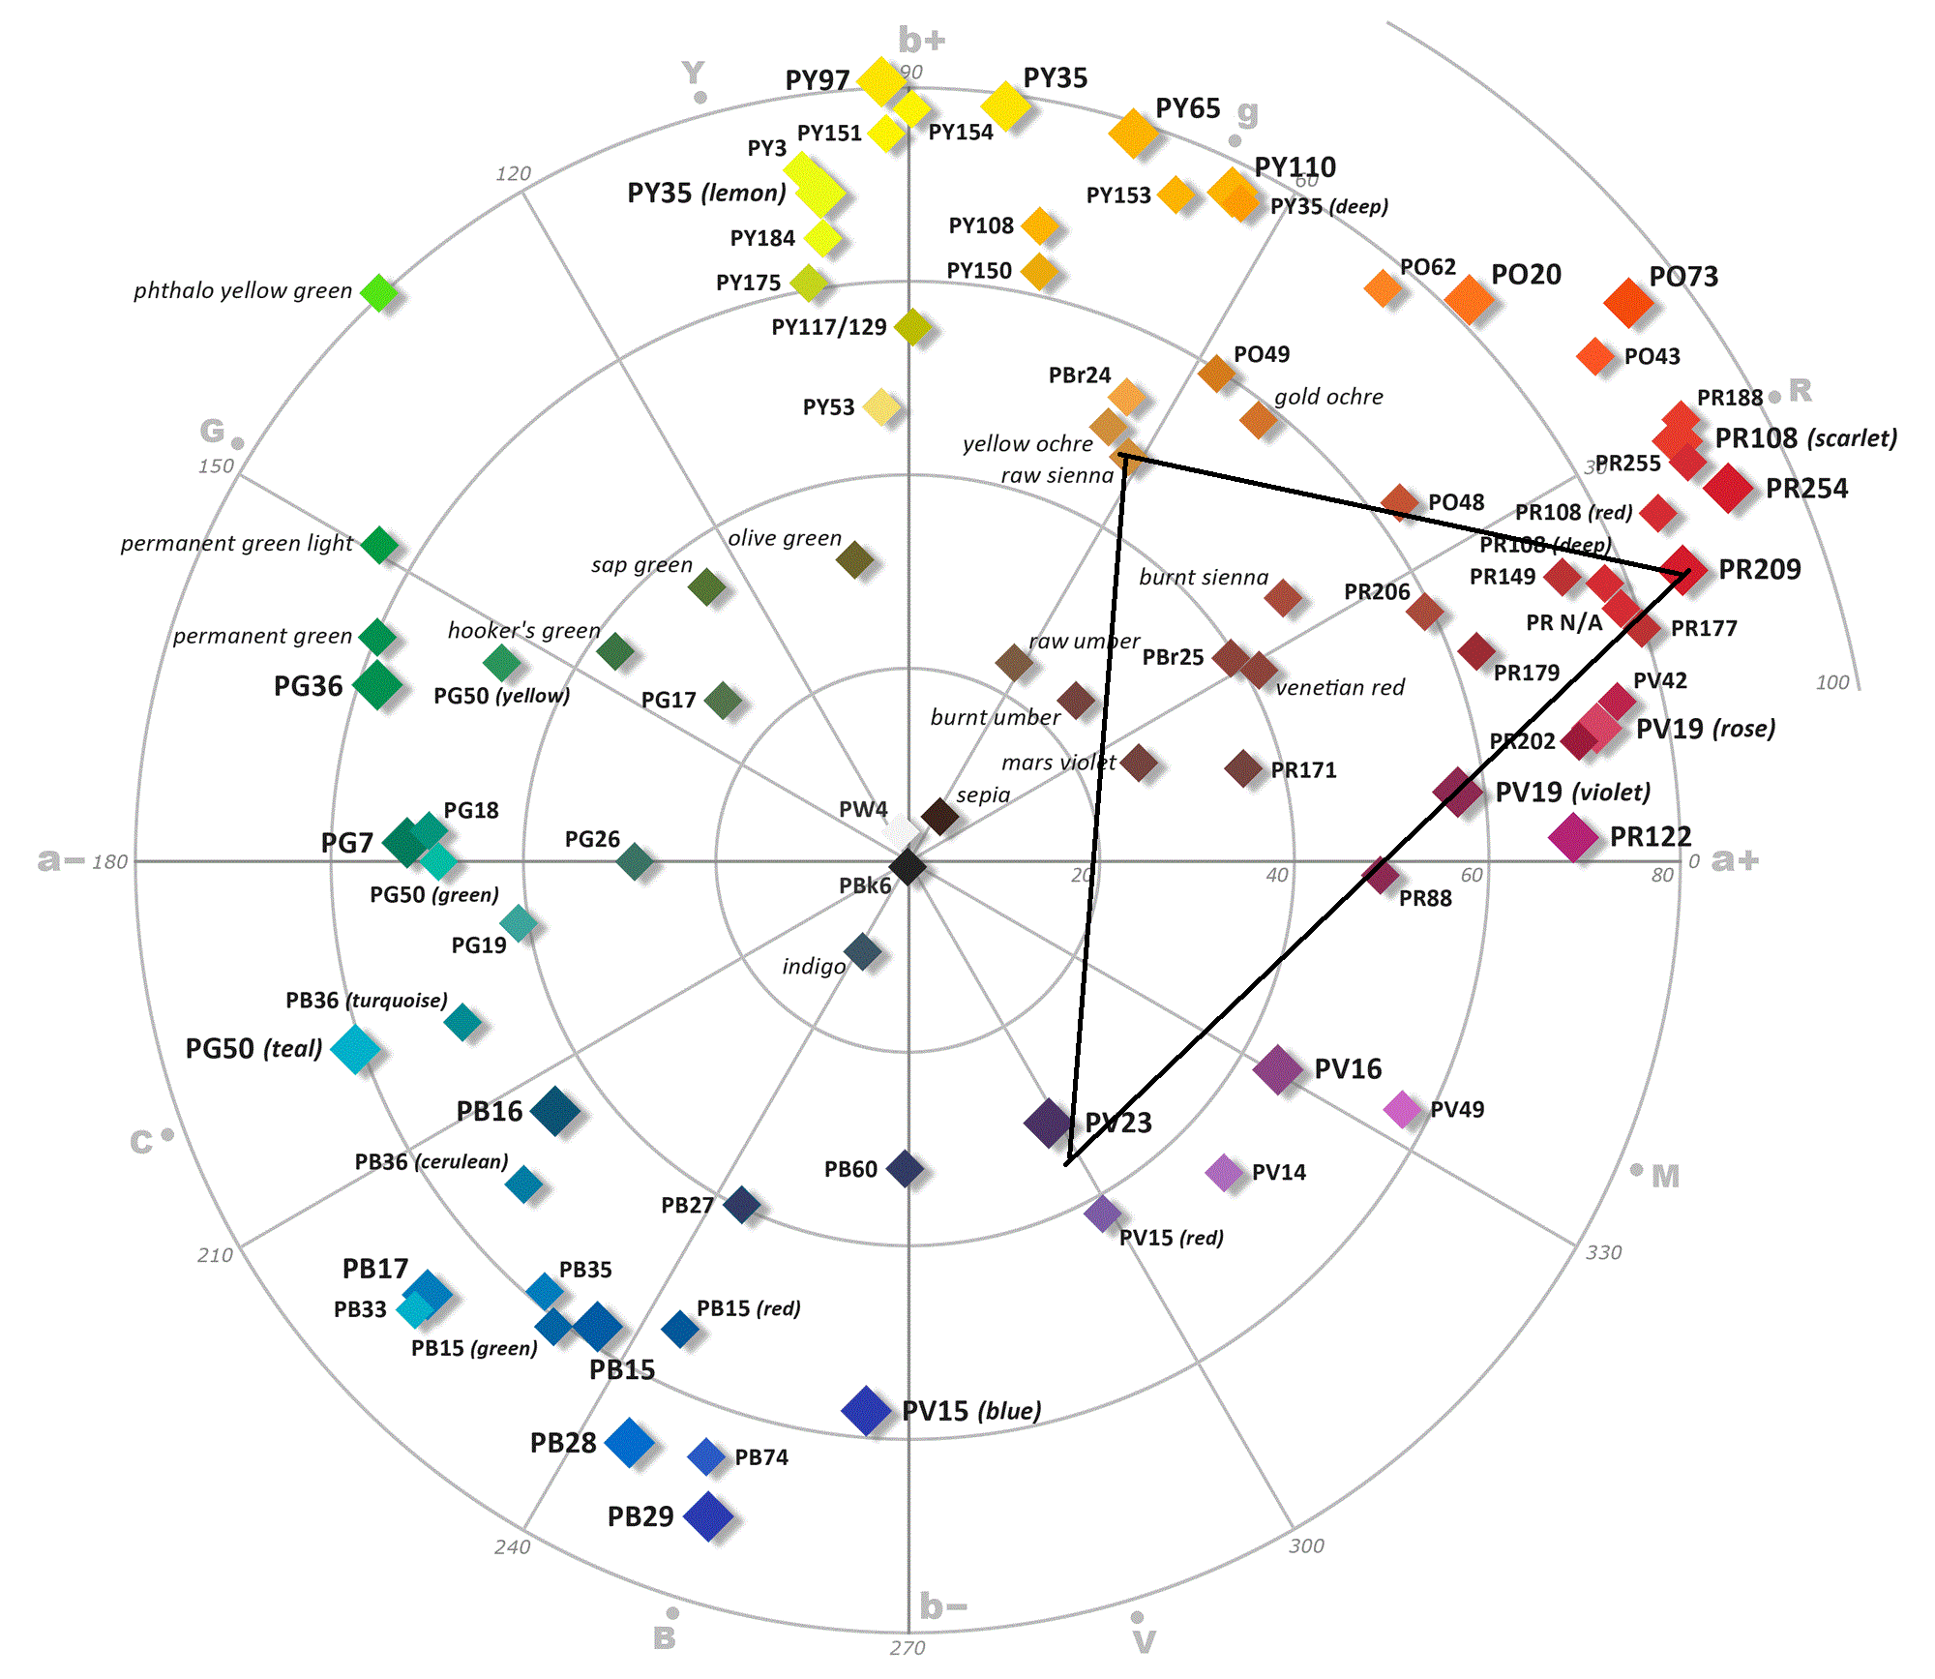
“Check” Gamut
Carbazole Violet
Raw Sienna
Quinacridone Coral
Notes:
‘Carbazole Violet’ was a new pigment from DS that I wanted to try
Needed a complement to the violet, but didn’t need saturated, so went with Raw Sienna
To add some depth and warmth, went with a warm, fairly neutral and high saturated scarlet – Quinacridone Coral
Looking at the gamut…
No greens possible
Not much in the blue range possible (the background was a ‘cheat’ – I used some Ultramarine Blue)
Dioxazine Violet is about a 9 on the value scale, so no problem with value range

Slide 28
Notes on “Check”
I wanted to experiment with a new pigment I had bought: Carbazole Violet (also called Dioxazine Violet) – an extremely high-tinting, medium saturation, slightly blue-violet
I knew I would need something that complemented the violet, which called for something in the yellow-orange range. I also realized the subject would not need a bright yellow (I seldom use a bright yellow in my portrait work anyway.) So, I went with Raw Sienna.
Next, I needed something to expand my gamut to the warm side, and I chose Quinacridone Coral, which is a warm, high-saturated color close to a scarlet.
Colors beyond the Gamut
Obviously greens
Not as obviously – blues
In terms of value range, Carbazole is about a 9 on the value range, so I could essentially use that as my ‘black’
Note: I cheated on the background; it is ultramarine blue

Slide 29
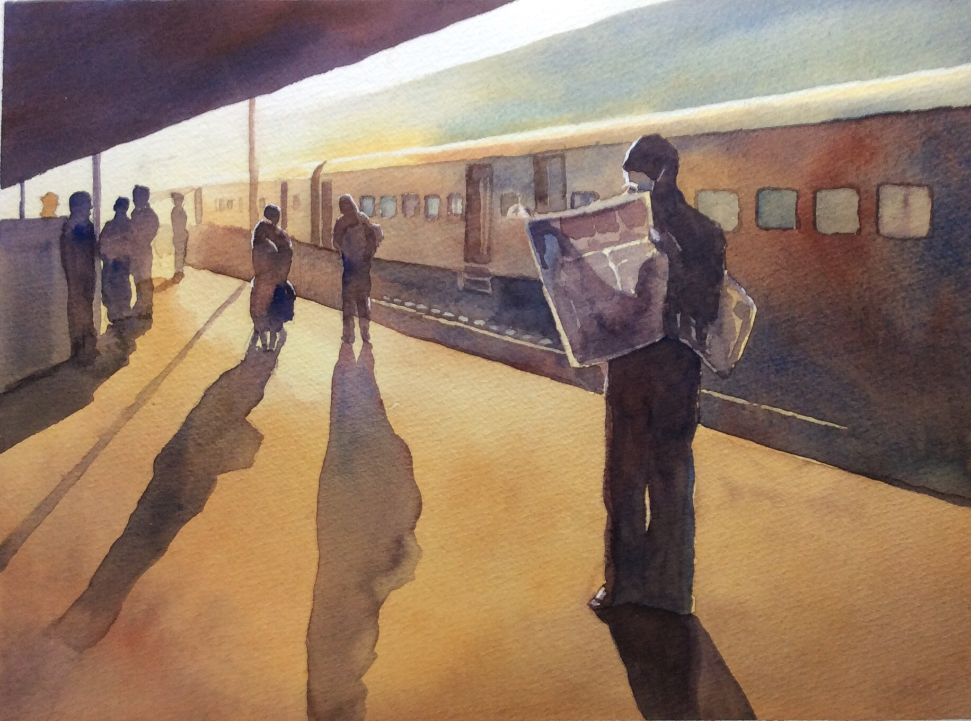
“The 7:15”

Slide 30
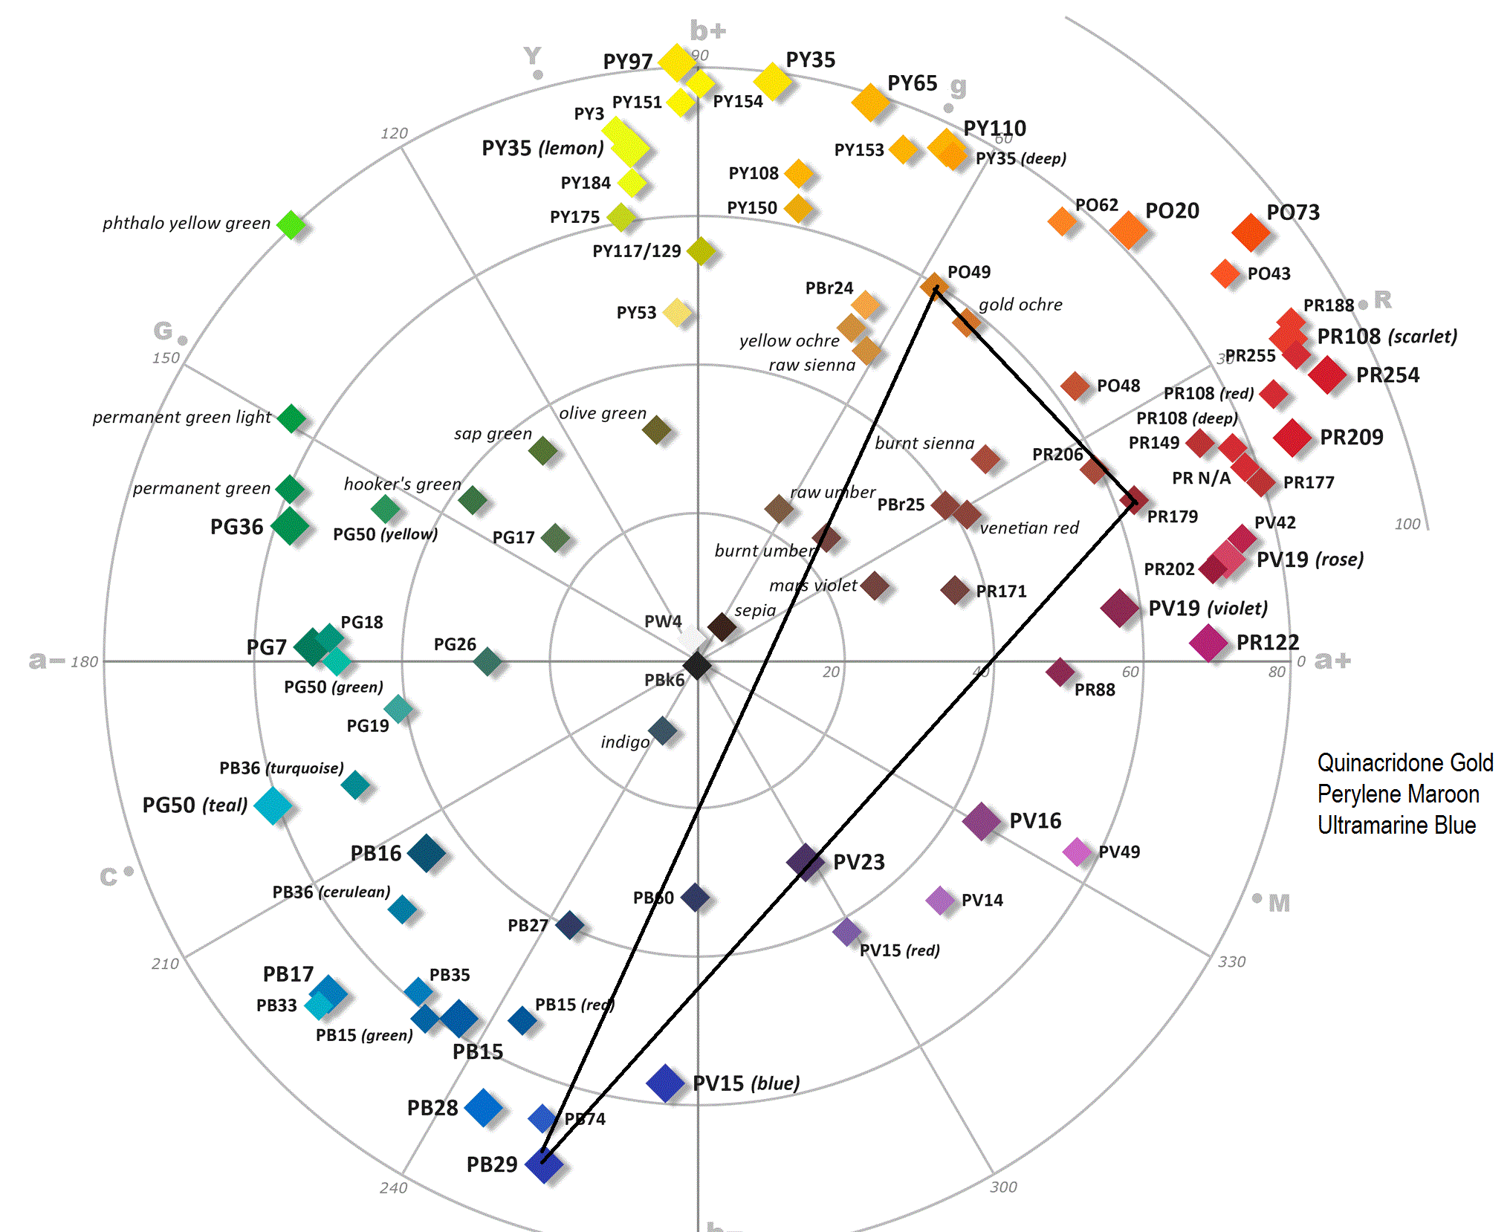
“The 7:15” Color Gamut

Slide 31
Notes on “The 7:15”
Started with an idea of what I wanted: a warm, morning glow, and deeply silhouetted figures. Whenever I think of ‘glow’, Quinacridone Gold comes to mind
I pictured some pale blues in the background, so I needed a good blue. I also wanted some granulation in the shadow mixes, so I went with Ultramarine Blue
Now, I needed something in the reds that would provide a way to give me dark values, and a way to tone down the gold. No need for a bright red, since my objects were in shadows, so I chose a strong, but low-saturated red: Perylene Maroon
Note the extremely narrow gamut. This is reflected in the painting.
There are no real greens possible, but see how the eye ‘sees’ a green in the area above the train.
The white of the paper must be used to provide the value range needed to project the dramatic lighting and the fading necessary to give the feeling of depth.

Slide 32
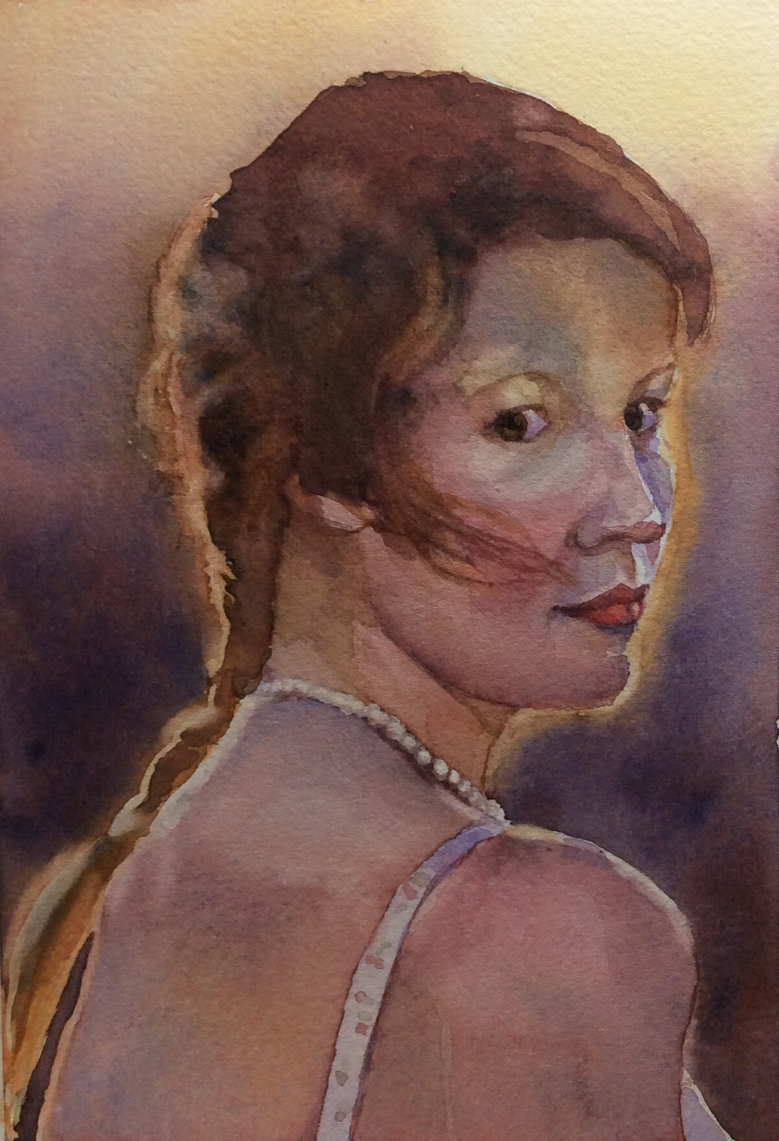
“Megan”

Slide 33
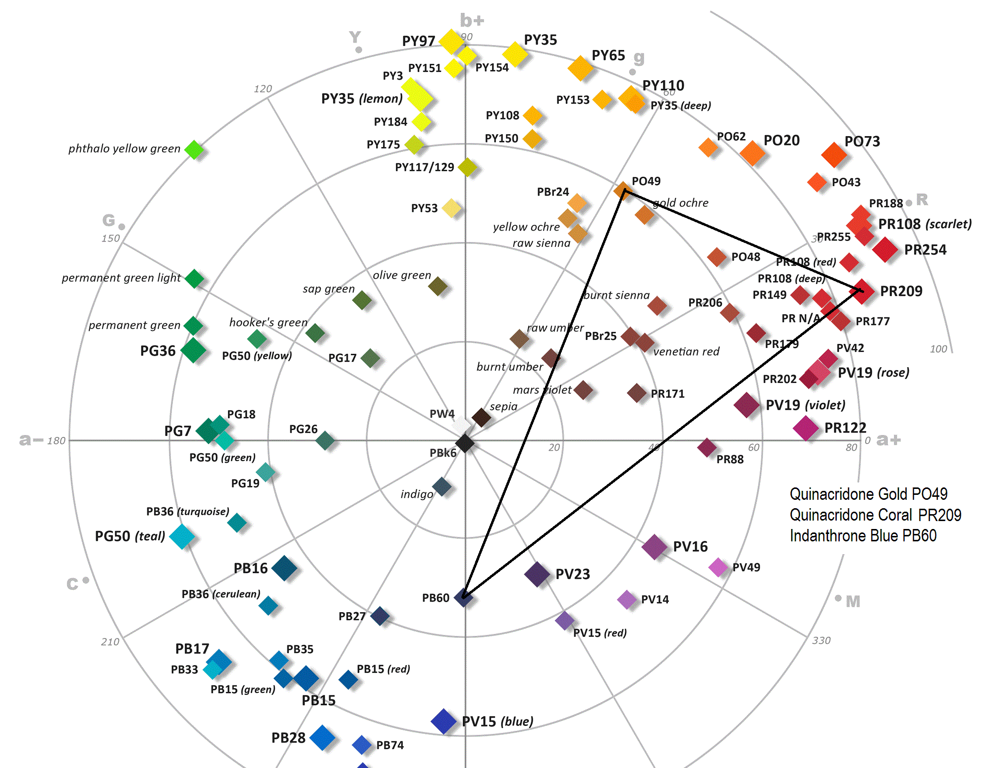
“Megan” Gamut

Slide 34
Notes on “Megan”
This is an example that is very closely related palette-wise to “The 7:15”
I wanted a lot of what I had in 7:15, but needed more facial detail, so I wanted a more saturated, and warmer red: Quinacridone Coral.
Without the deep dark perylene red, I would need a darker-valued, stronger tinting blue than Ultramarine in order to achieve deep browns and a full range without losing transparency. Also, I didn’t want granulation in this piece, so I chose Indanthrone Blue – which is a less saturated, but stronger-tinting version of Ultramarine.

Slide 35
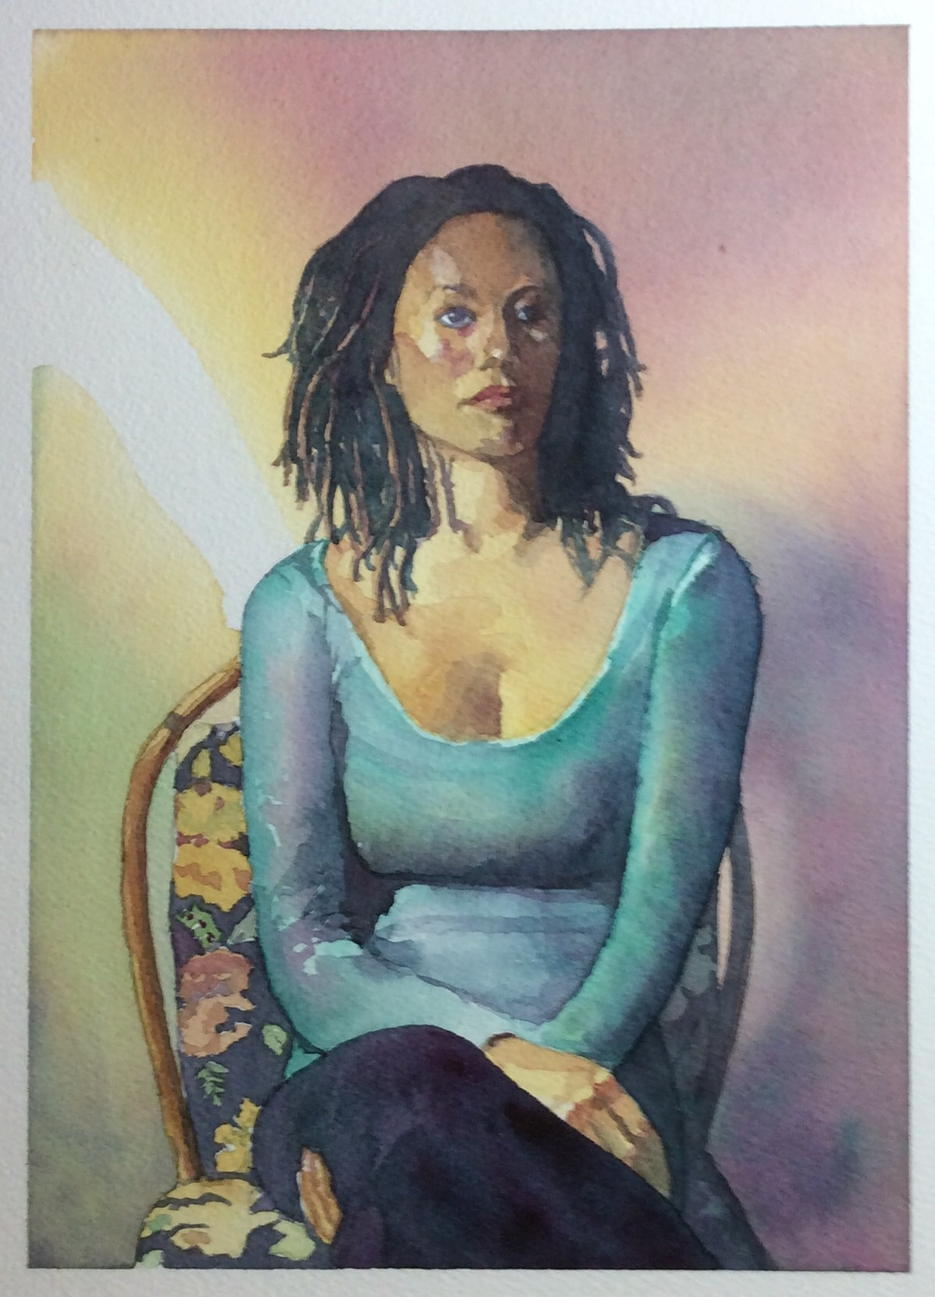
“Emerald Lady”

Slide 36
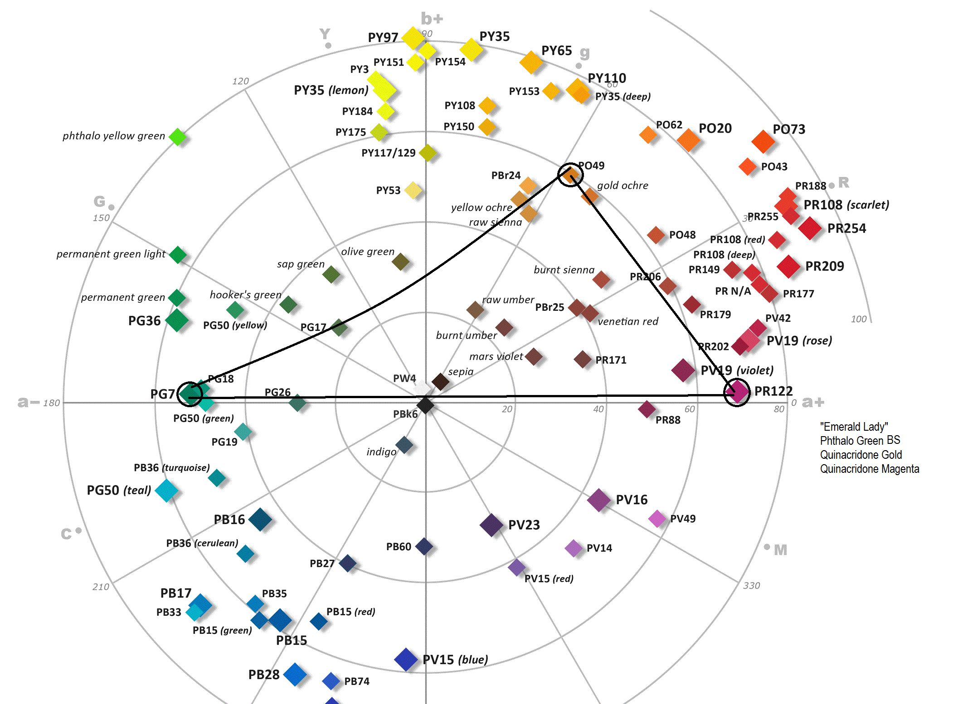
“Emerald Lady” Gamut

Slide 37
Notes on “Emerald Lady”
What struck me most about the photo I was working from was the emerald color of the sweater. So, I decided to anchor my palette with Phthalo Green (BS)
My most pressing problem was how to get skin tones. Most of my paintings are of people, and therefore I rarely choose a green in a triad palette. I needed something to pull the palette to the warm brown side – Quinacridone Magenta is about directly across from Phthalo green.
I decided to go with Quinacridone Gold to finish out my need for building browns.
From the gamut, blues are pretty much impossible, and any strong reds are as well. There are plenty of orangish/reddish browns, so skin tones should work except where I might need more pink. Since this figure had dark skin, this wasn’t a big issue.
The Phthalo Green BS and Quin Magenta are both fairly dark on the value range, so that allows me to build a pretty good dark neutral.
Note that reds ‘appear’ where the gold meets the magenta, and blues can be ‘seen’ where magenta meets the green
On re-analyzation of the results, I decided I probably should have chosen an orange rather than the gold. This would allowed me to make warmer skin tones, and get better reds.
In addition, the dark end of the value range is not quite well enough represented. This results in loss of transparency in areas where I need to give the image of darks (hair, pants).

Slide 38
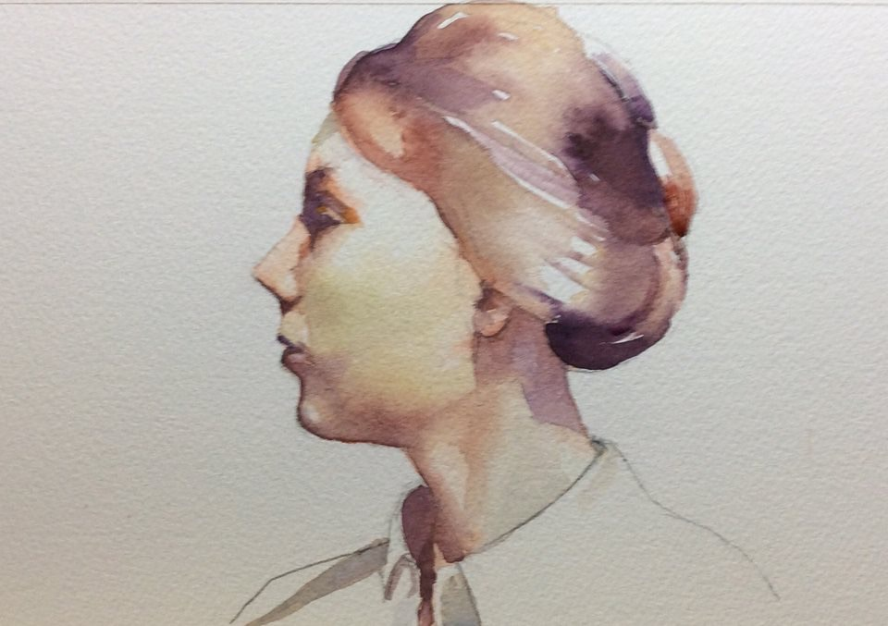
“Lesley”

Slide 39
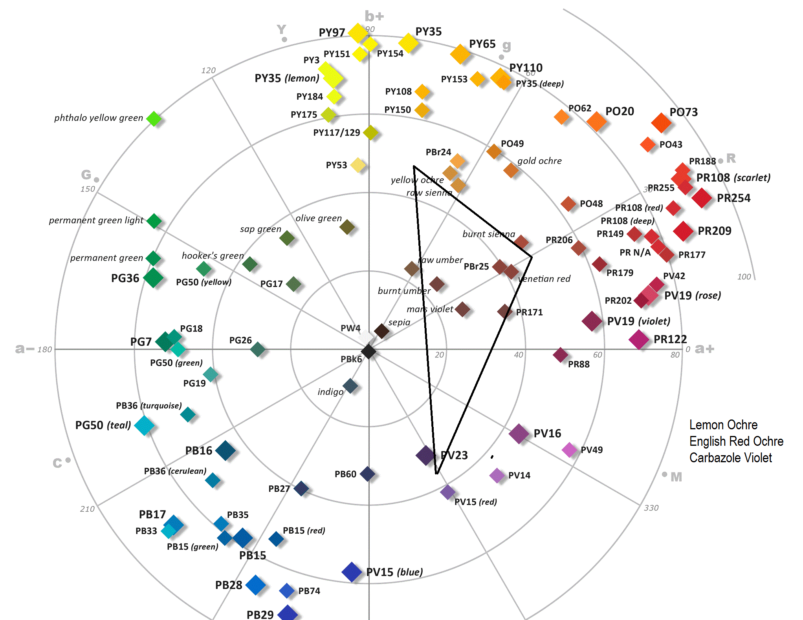
“Lesley” Gamut

Slide 40
Notes on “Lesley”
I wanted a simple, earthy portrait. One of my favorite earth yellows is Lemon Ochre – an especially bright and transparent yellow ochre from Rublev.
To keep the entire portrait earthy, I chose and earthy red: English Red Ochre – a nice transparent pigment from Dan Smith
To extend the value range and produce solid browns, I again called on Carbazole Violet
Note, despite the non-existence of a blue in the palette, one can see a tinge of green in the cheek.

Slide 41
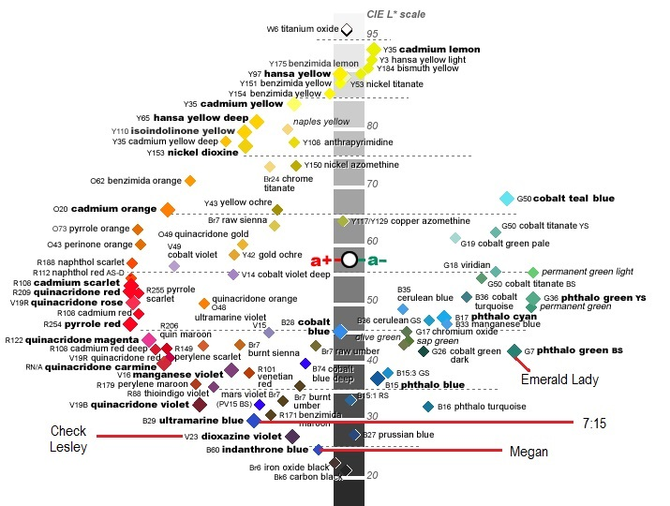
Choosing a pigment for Dark Values

Slide 42
Notes on the Value Range selection
I rarely use black (or the famous Payne’s Gray) to move my colors to the dark end of the value range. I prefer to select pigments that can represent these darks
A cross-section of the color solid can up help select pigments for value range decisions
In each of the examples I had a dark-valued pigment
Carbazole Violet for Check and Lesley
Ultramarine Blue for The 7:15
Indanthrone Blue for Megan
Phthalo Green BS and Quin Magenta for Emerald Lady
Of all of these, Emerald Lady is where I had the most difficulty creating the dark end of the value range.

Slide 43
Summarizing…

Slide 44
Selecting a Limited Palette
Decide on a subject matter, and determine what range of colors and values you will need, or pick some pigments and see where it leads you
Pick 3 or 4 pigments
Be Brave
Ignore pre-conceived concepts – like you can’t mix a ‘primary’
Use a COLOR CHART to help select colors that will produce the color range you need and draw up your color GAMUT
Looking at your gamut may show you colors that you feel you might need, but cannot mix. Adjust your selections accordingly
Mix swatches with all combinations
Paint a painting with your choices

Slide 45
Challenges with a Limited Palette
Value Range
Watercolorists have paper for their white, other mediums must add white to the palette
If black is not a good choice for achieving your dark values, you must have at least one dark-valued pigment
Saturation range
Some subjects require intense, saturated color. You cannot mix colors as saturated as ones straight from the tube – there is always a ‘saturation loss’ when mixing. (There are a few exceptions.)
On the other hand, if you choose only saturated colors, you will have to mix your muted colors
Pigment material attributes:
Remember, pigments are NOT ‘colors’. Two pigments could be the same color, but react differently in mixes
Pigment characteristics, such as lean/fat, granulating, transparency, staining
Some pigments just feel better to use.

Slide 46
Some examples of Artist’s using Limited Palettes

Slide 47
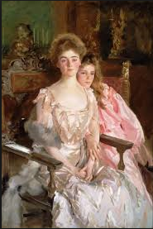
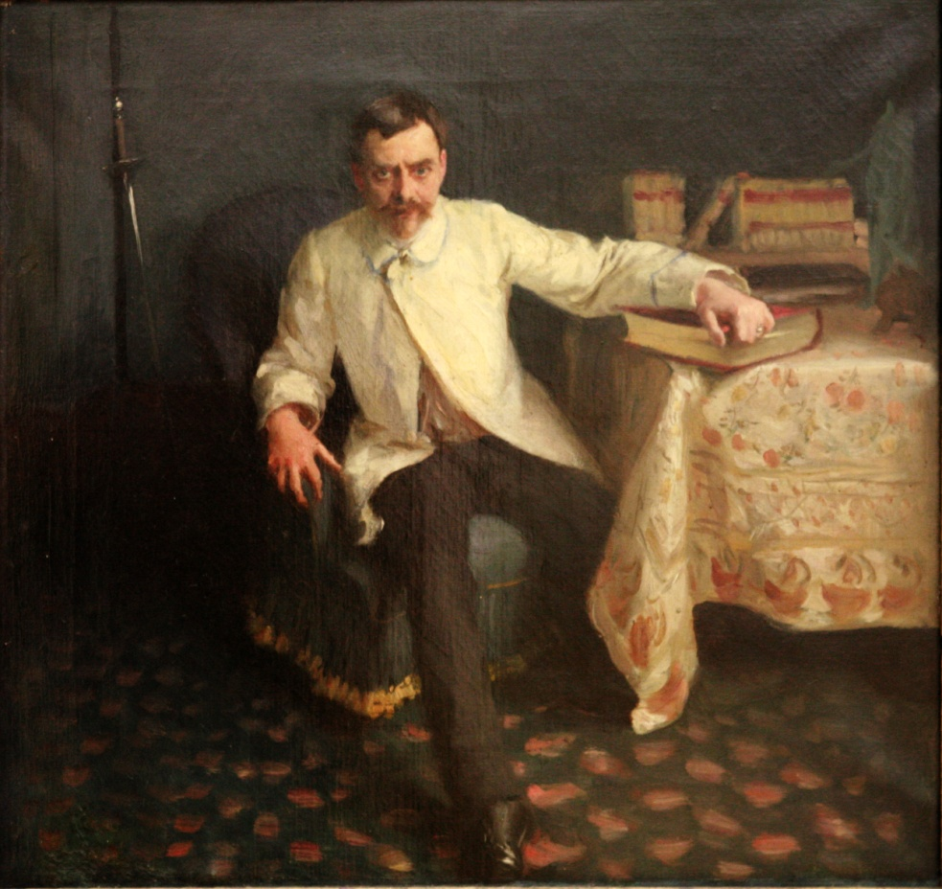
John Singer Sargent

Slide 48
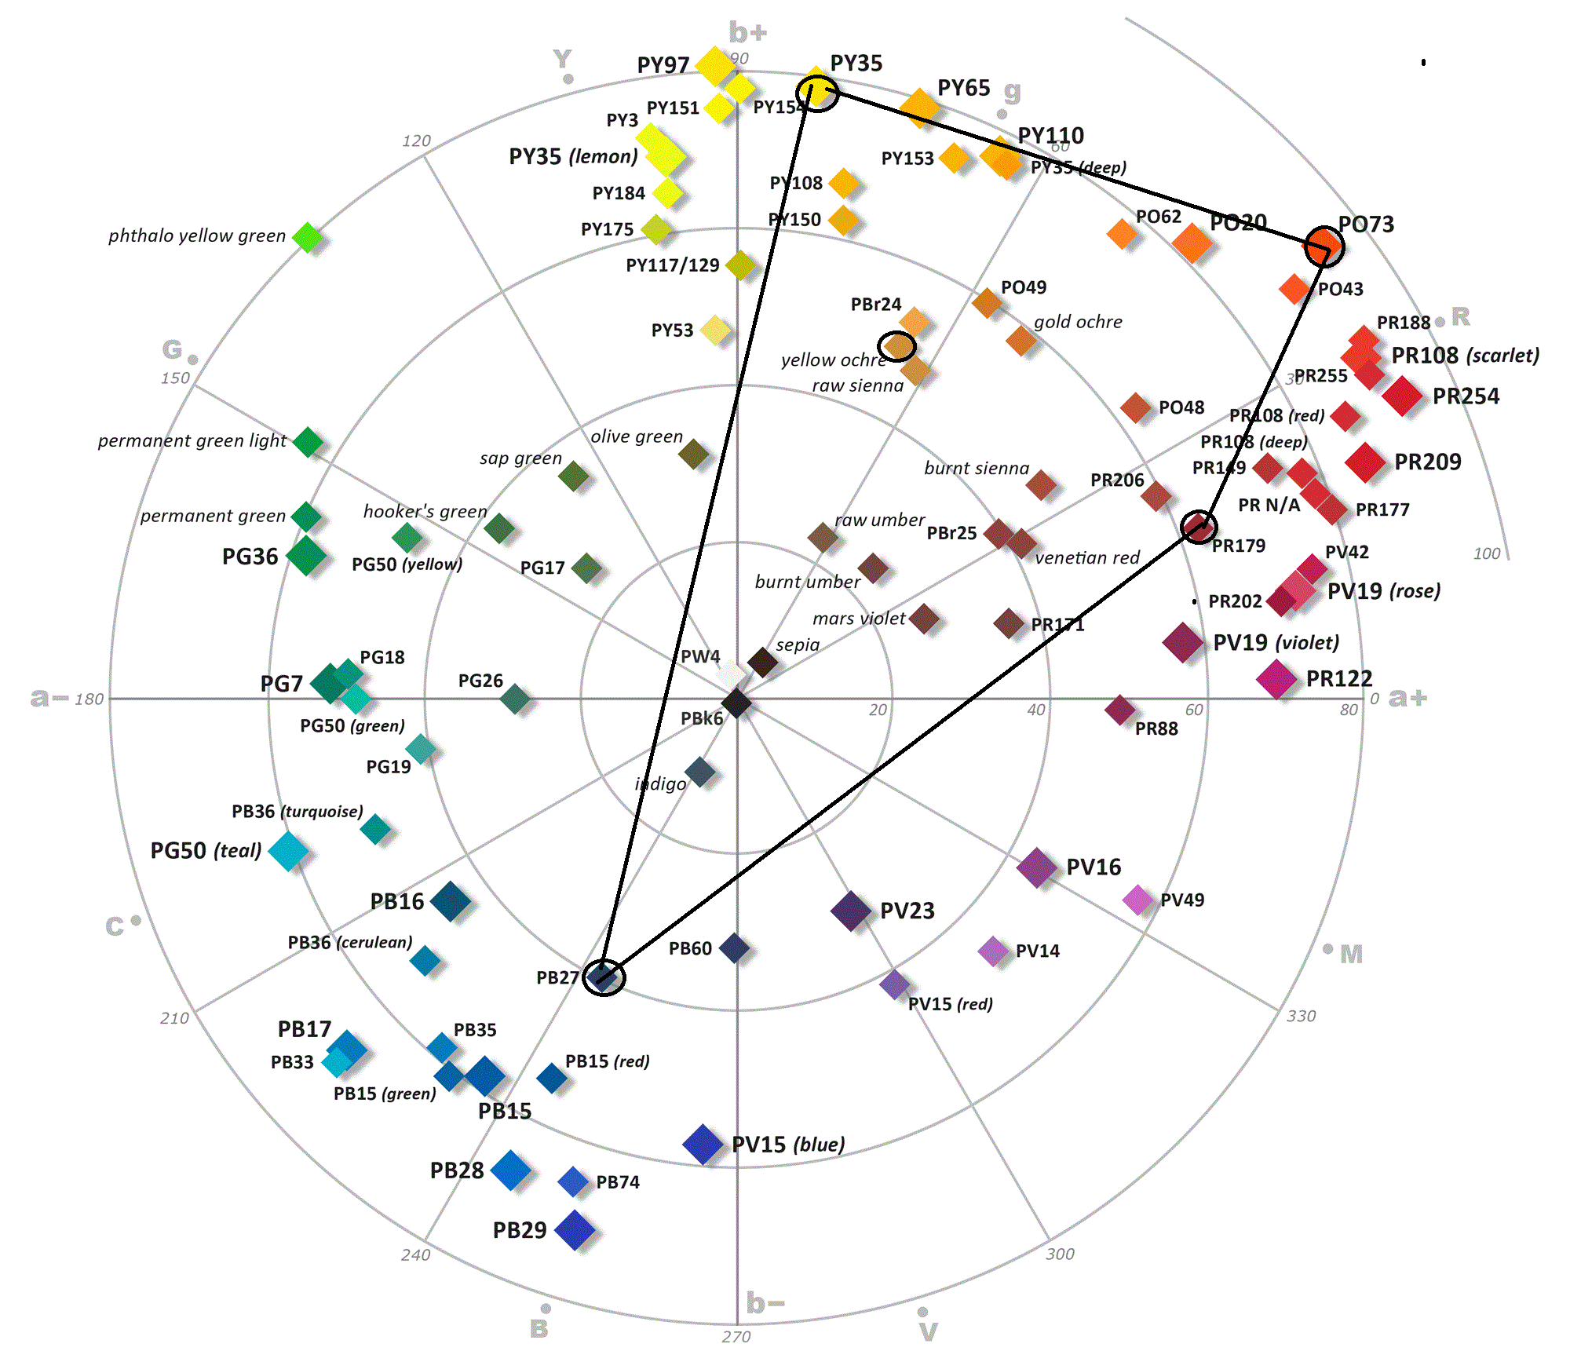
John Singer Sargent’s
Oil Palette

Slide 49
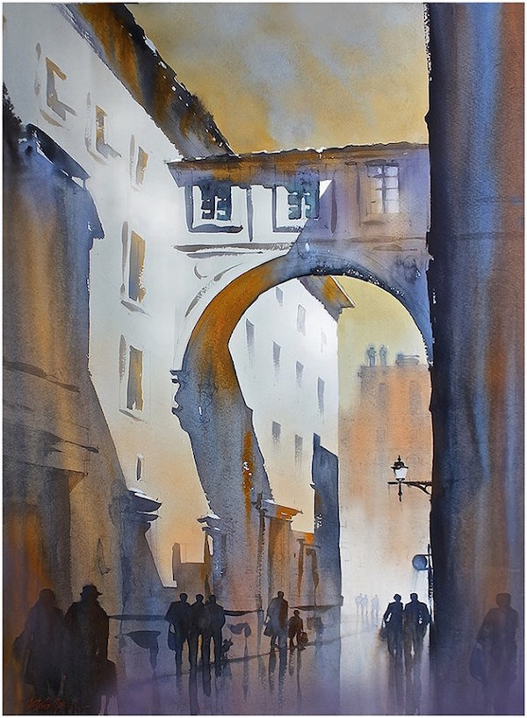
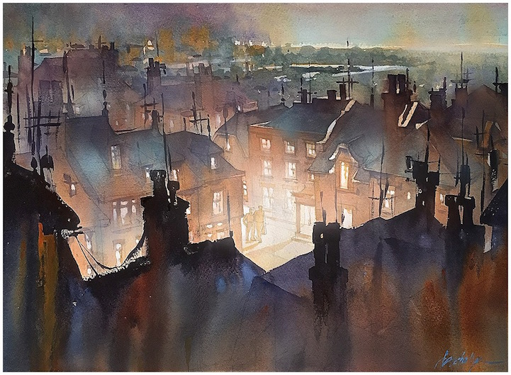
Thomas Schaller
In his more recent paintings, Thomas has started limiting his watercolor palette.
Note his use of complementary blue versus earthy yellow and reds.

Slide 50
Some Side notes

Slide 51
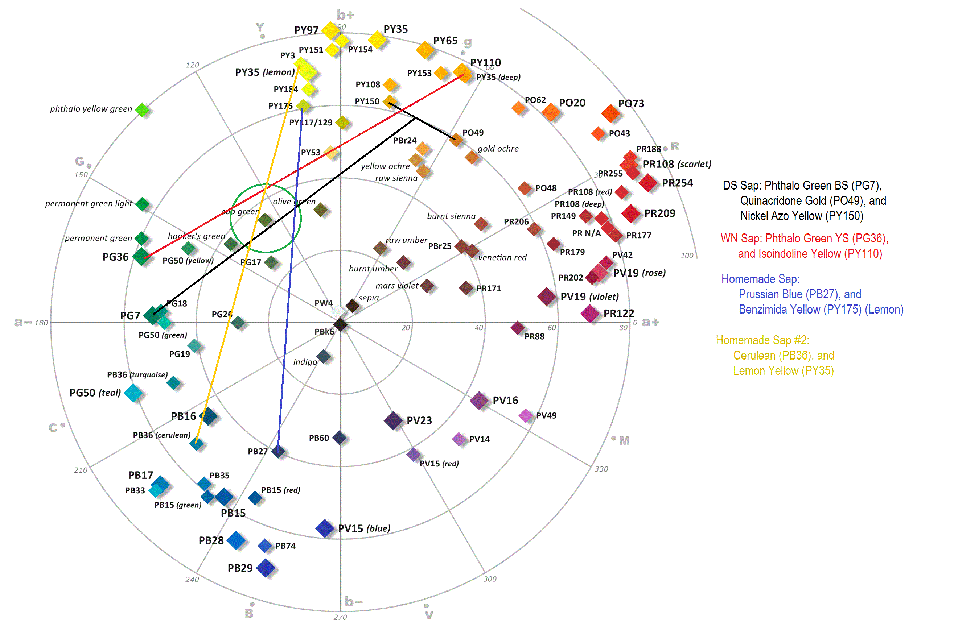
Mixing Sap Green 4 Ways

Slide 52
Notes on Mixing Saps
What I have shown in this diagram are 4 different mixes of Sap Green. Two of them are using the formulas from two popular pigment manufacturers, and the other two are just homemade. Each of the mixes have slightly different results.
Note that Dan Smith Sap Green mix actually uses 3 ingredients – 2 yellows and a green.
Whenever you contemplate buying a new pigment, be sure and check its ingredients. It may be a mix. If so, and if you have the same ingredients, you can mix it yourself. Alternatively, find the color on the pigment chart and draw some mixing lines using ingredients you have and see what similar colors you can mix yourself.
Sap Green and Payne’s Gray are two of the most common mixes from artist pigment manufacturers. There is a large variety in the ingredients, be sure to determine what the ingredients are to verify that the ingredients fit your style of palette. For example, some Payne’s Grays are made with Phthalo Blue (W/N), some with Ultramarine Blue (Dan Smith). The ones with Phthalo will be stainers, since Phthalo is a stainer. The ones made with Ultramarine will not stain, but will tend to granulate more, since Ultramarine blue is a granulator.

Slide 53
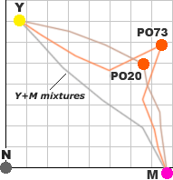
Mixing Line Discrepancies
Mixing a mid-yellow and a magenta with two oranges that have the same Hue: PO73 – Pyrrol Orange, and PO20 – Cadmium Orange
What the two lines tell us is that, even though PO73 is considerably more saturated than PO20, the mixes with PO20 are consistently more saturated than those with PO73. This might explain why Cadmium Orange is very popular.
Lesson: Not all pigments that have the same HUE will have the same mixing characteristics.

Slide 54
Acknowledgments
Much of the material in this presentation is a simplified version of information available on Handprint.com by Bruce McEvoy.
Many of the diagrams are directly from Handprint, or modified versions of diagrams found on Handprint.
I encourage anyone that would like a more in-depth coverage of this type of material to visit handprint.com. It is, by far, the most comprehensive site dealing with color theory for the artist.
Thanks to Bruce for his work in maintaining that site. I have learned more from it than any other source I have found.
Thanks to my wife Cindy for putting up with me as I curse the technology, and helping me edit this presentation, and for insuring it gets posted online for those that want to use it as a reference.

